Slide 1
HR ANALYTICS GROUP CASE STUDY
Group Members:
Vijayanand Narayanan
Arunachalam Meenakshisundaram
Akash Ashokan
Dharamarajan Thiyagarajan

Slide 2
Business Problem
Company XYZ faces a high employee attrition rate of 15% annually. This is a huge concern for the company.
This high attrition rate poses the following issues,
Projects not delivering on time, hence earning a bad reputation amongst customers and clients
Forces company to maintain a sizeable department to cover for leaving employees
Increases training costs for the company to train new employees

Slide 3
Objectives
Carry out research and conduct analysis using past data of employees to fulfil the following objectives,
Understand the factors that have a significant impact on employee attrition
Model the probability of attrition using Logistic Regression
Recommend changes to reduce attrition and create an environment for the employees to stay

Slide 4
Problem Solving Methodology
Understand Business Problem
Define project objectives and expected outcomes
Use data files provided
Clean data and address all data quality issues
Perform Exploratory Data Analysis
Create derived metrics
Create Dummy variables for Categorical variables
Identify the target and other predictor variables
Create Training and Test datasets
Develop a Logistic Regression model using training data
Fine tune model to avoid overfitting
Select the appropriate model based on performance metrics
Predict attrition rate using test data
Verify quality of prediction
Make recommendations for company

Slide 5
Data
Data from the following datasets were used in this project,
Employee Survey Data – Survey data of employees, 4410 Observations, 4 Variables
Manager Survey Data – Survey data of managers, 4410 Observations, 3 Variables
General Data – Personal data of Employees, 4410 Observations, 21 Variables
In Time – Log in time of Employees for the entire year , 4410 Observations, 250 Variables
Out Time – Log in time of Employees for the entire year , 4410 Observations, 250 Variables

Slide 6
Data Preparation
Following steps were taken to clean up the data
Looked for duplicate records
Checked for outliers in the variables
Handled missing values
Removed holiday columns from In Time and Out Time files
Converted character to date format
Removed single value columns
Converted categorical variables into numerical by using dummy coding
Scaled numerical values for regression

Slide 7
Derived Metrics
3 new variables were derived from the provided data for analysis,
Average Hours Worked by an Employee for the year – Average working hours for each day for the entire year for each employee
Employee worked overtime – If daily average working hours of an employee is greater than the standard 8 hours then the employee has worked overtime
Number of Leaves taken by an employee – If it is not a holiday or weekend and NA appears for the day for the employee in both In and Out Time files then it is a holiday taken by the employee

Slide 8
Univariate Analysis – Attrition Rate

Slide 9
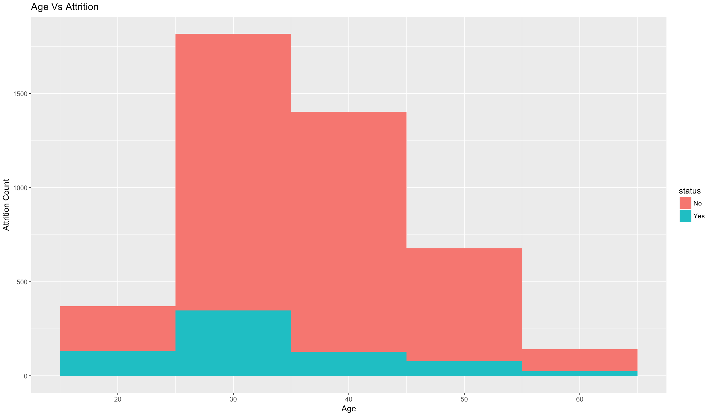
Bivariate Analysis – Age vs Attrition
Ages between 25 and 45 have the most number of employees leaving the company
Attrition is very low for employees above the age of 55

Slide 10
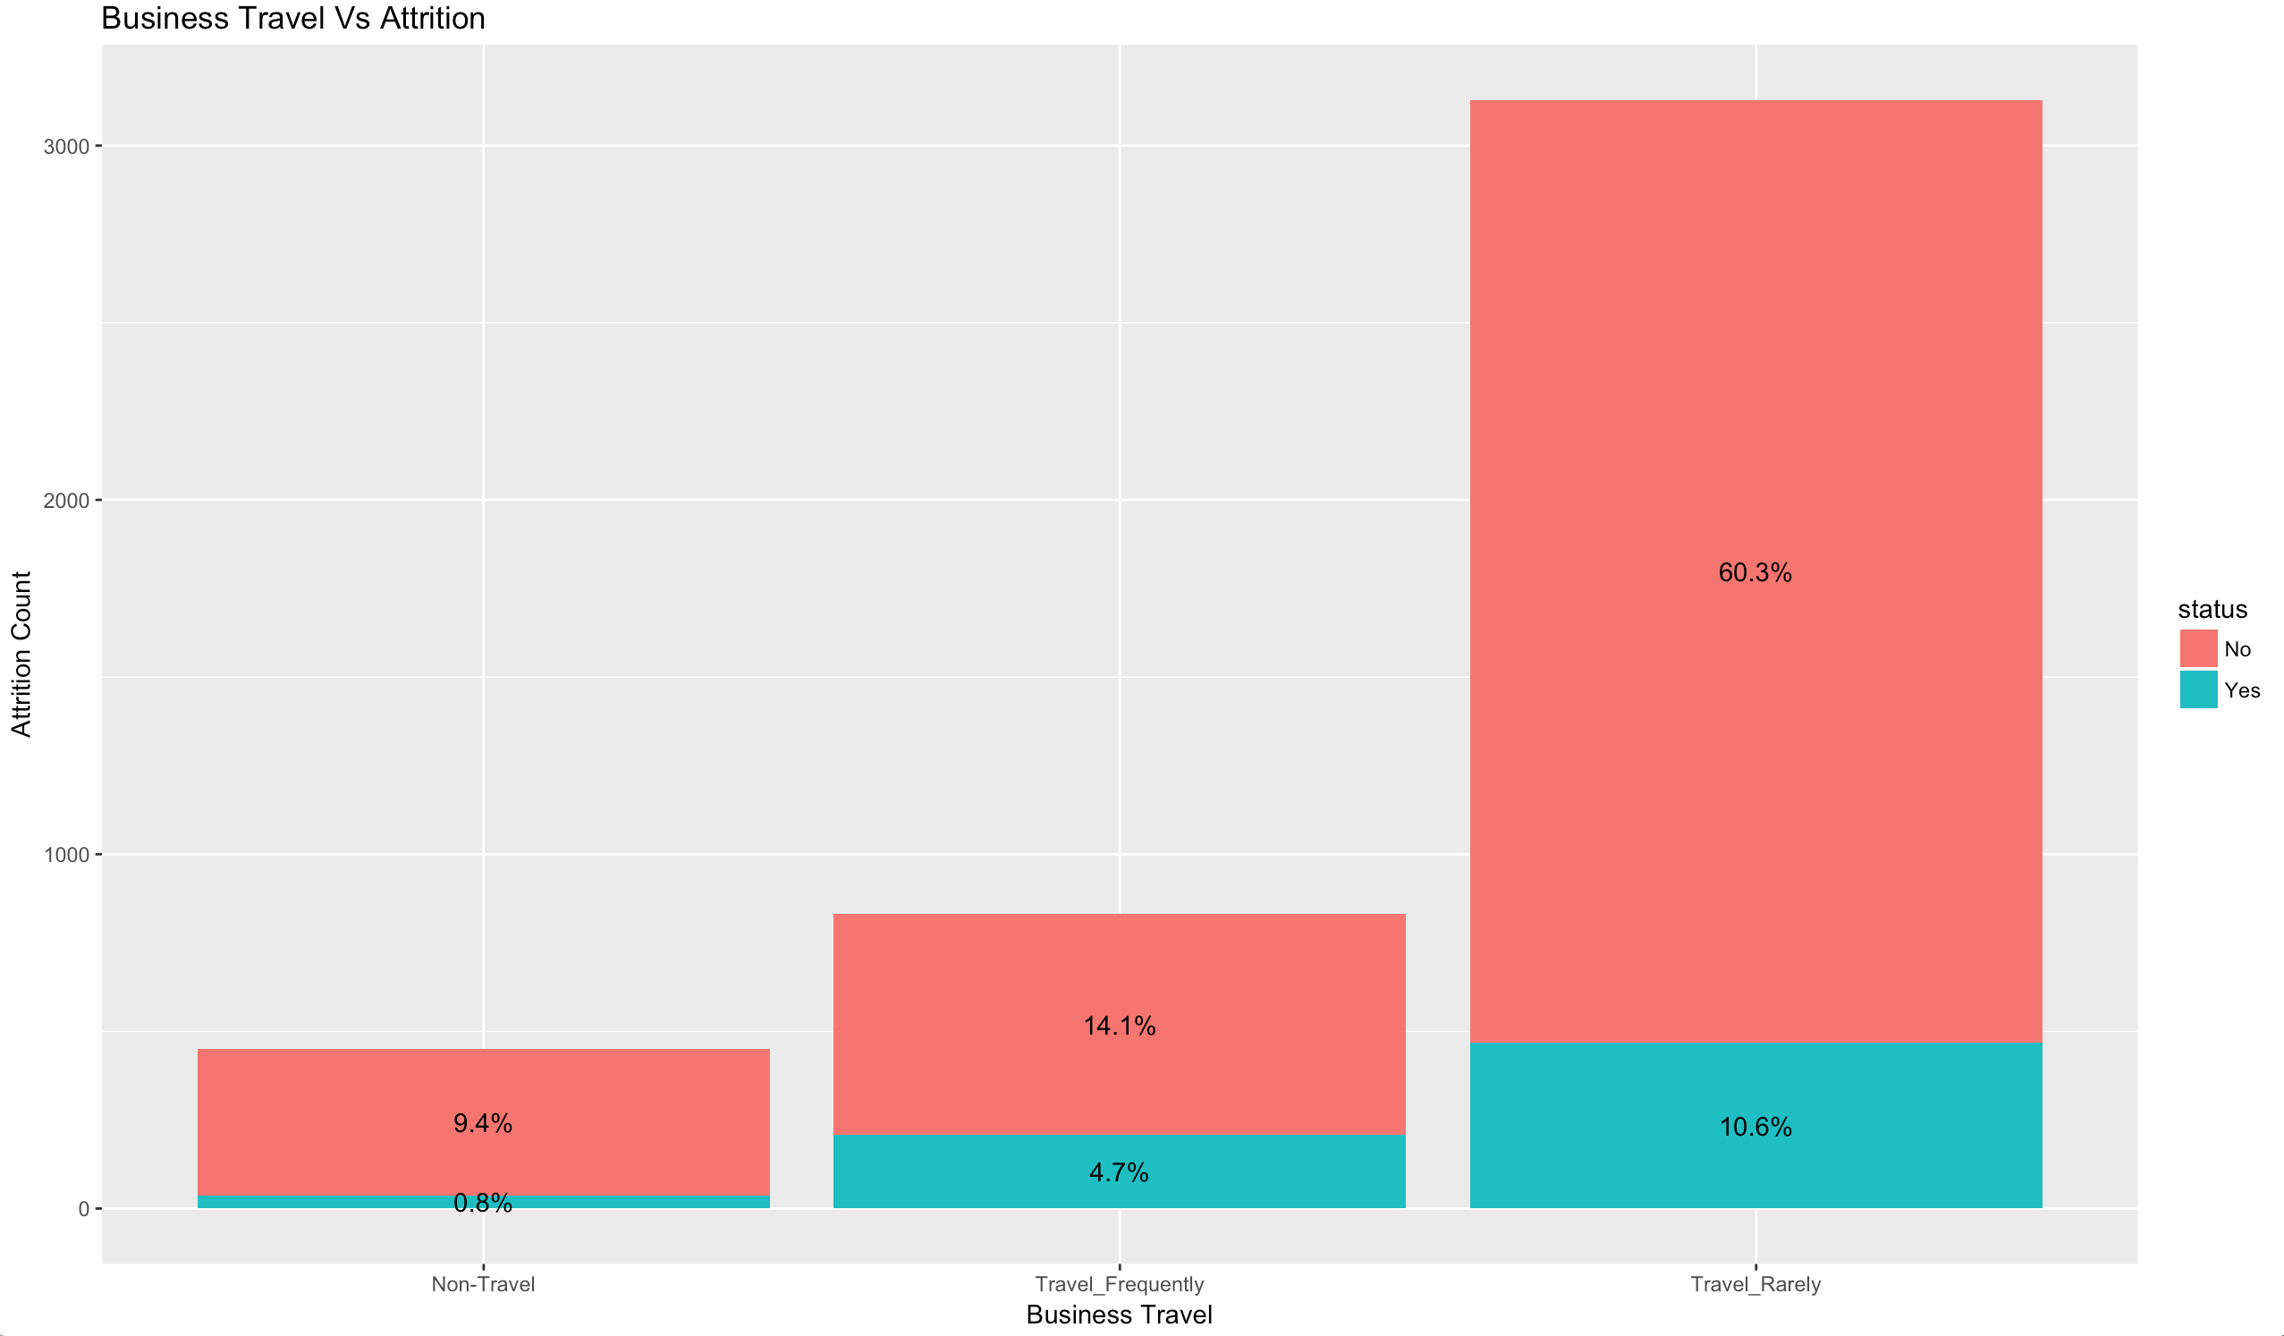
Bivariate Analysis – Business Travel vs Attrition
Nearly 11% of employees who rarely travel leave the company
Attrition is the lowest < 1% for employees do not travel at all

Slide 11
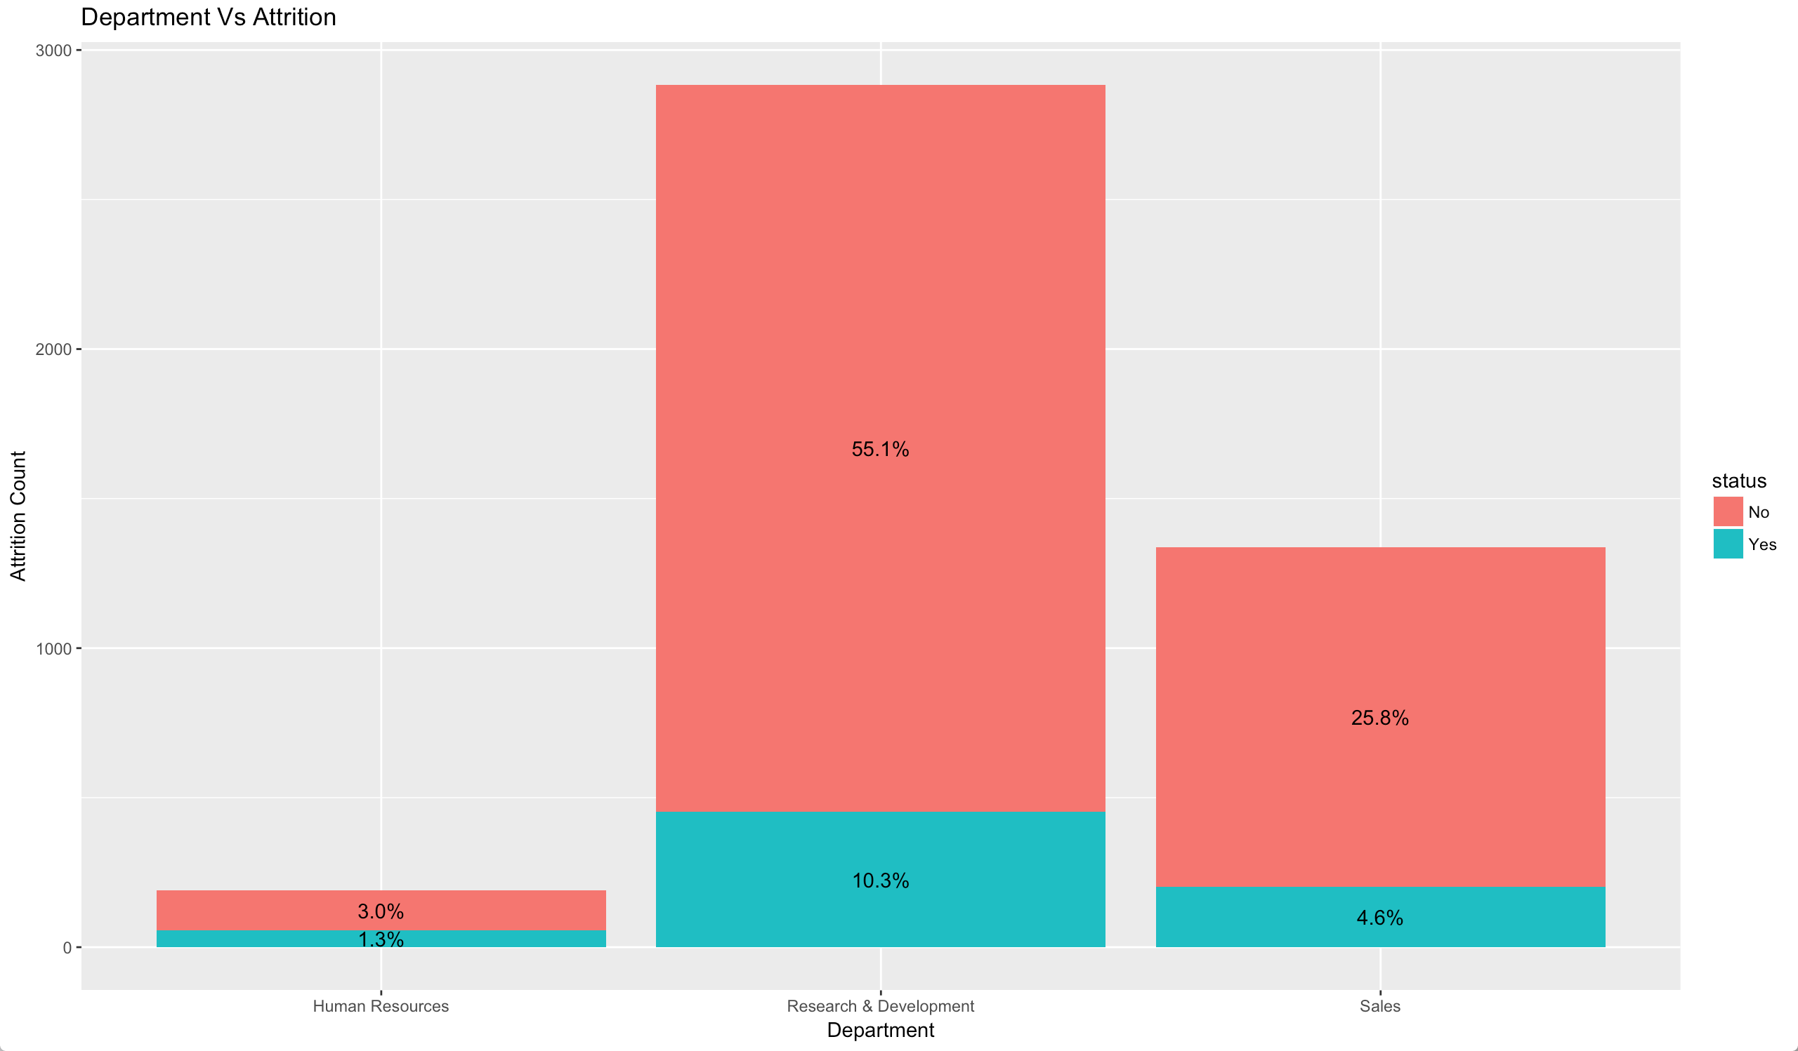
Bivariate Analysis – Department vs Attrition
Attrition is the highest in R&D department with 10% of employees choosing to leave
Attrition is the lowest 1.3% in Human Resources department

Slide 12
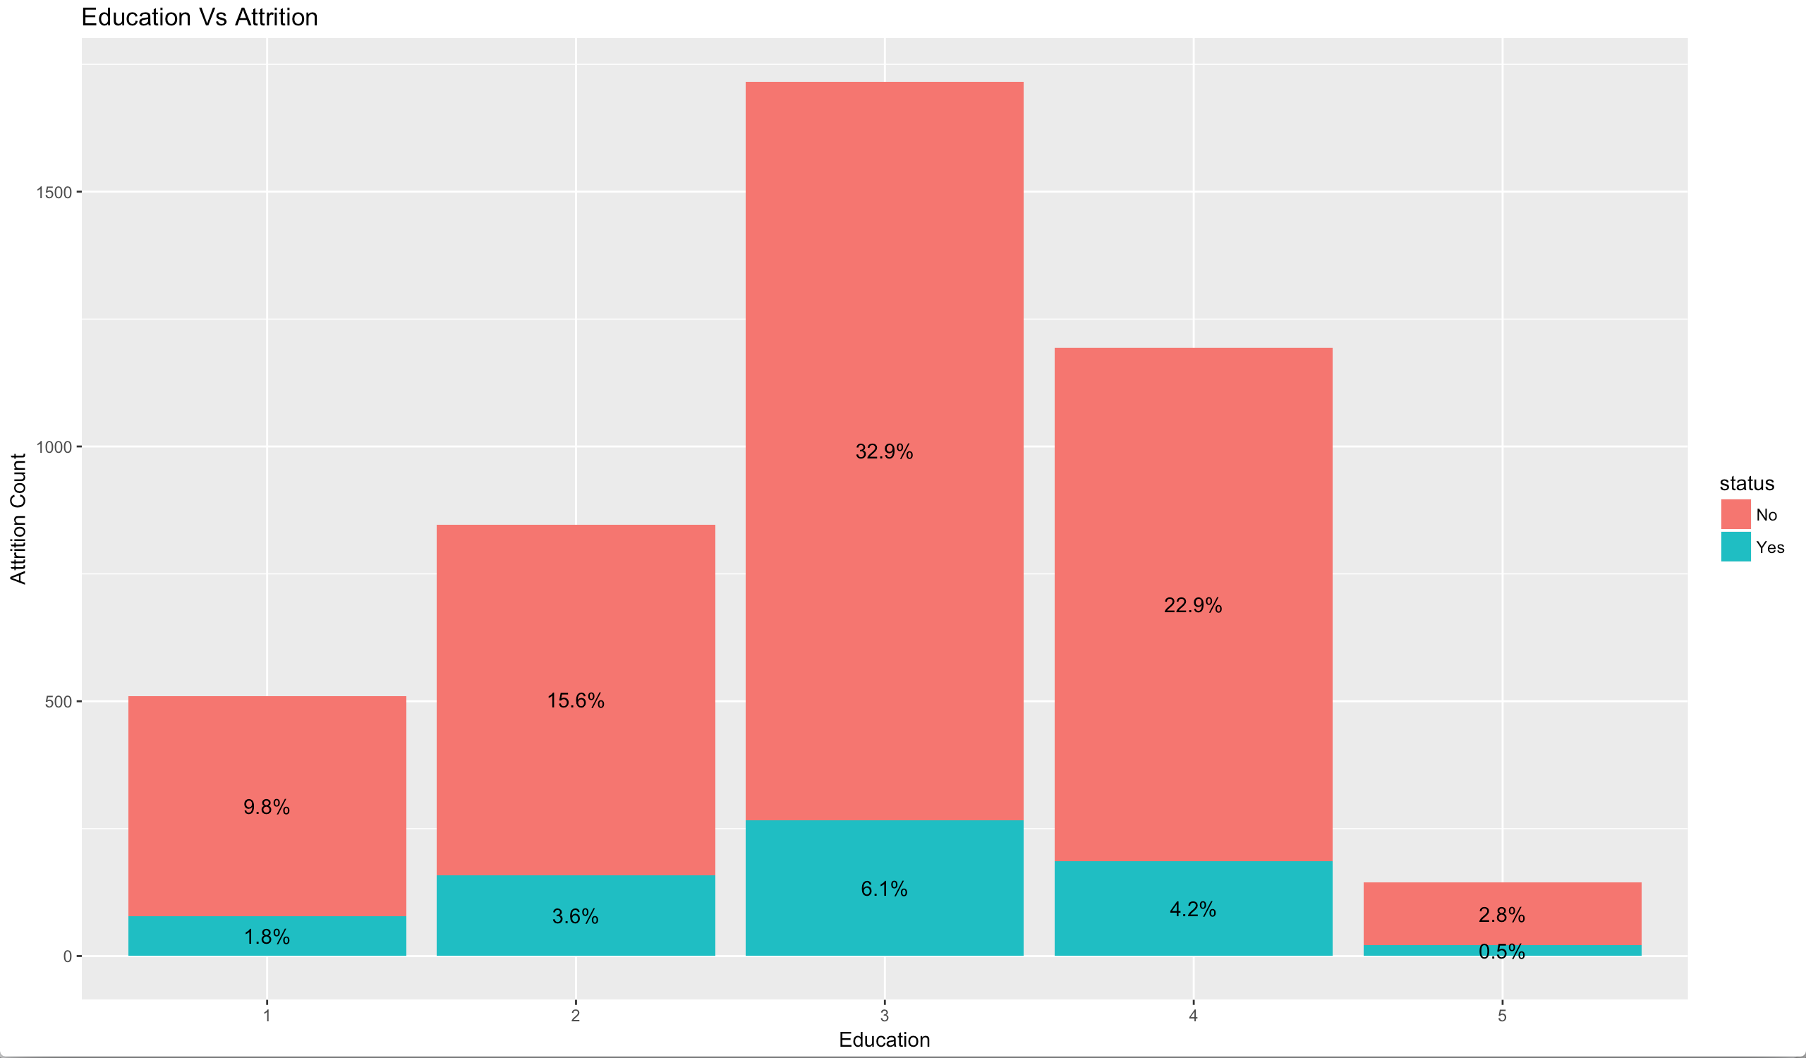
Bivariate Analysis – Education vs Attrition
Attrition rate is highest with 6.1% of employees with Bachelors degree left the company
4.2% of employees with Masters degree left the company
Attrition rate is very low for employees who have Below College level education or Doctorate degrees

Slide 13
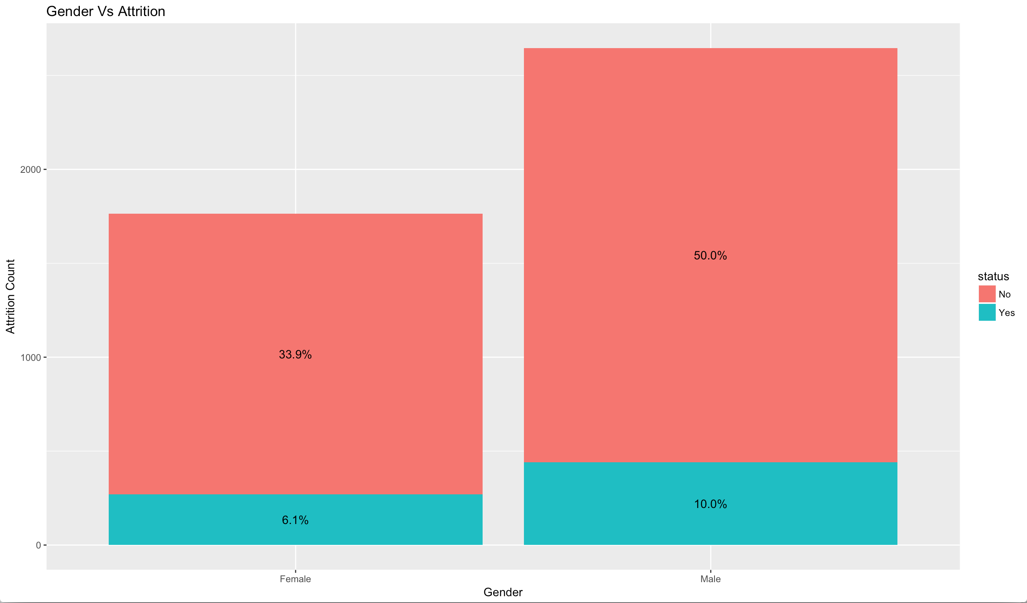
Bivariate Analysis – Gender vs Attrition
Attrition is higher in Males than Females with 10% of Males choosing to leave the company compared to 6.1% of Females

Slide 14
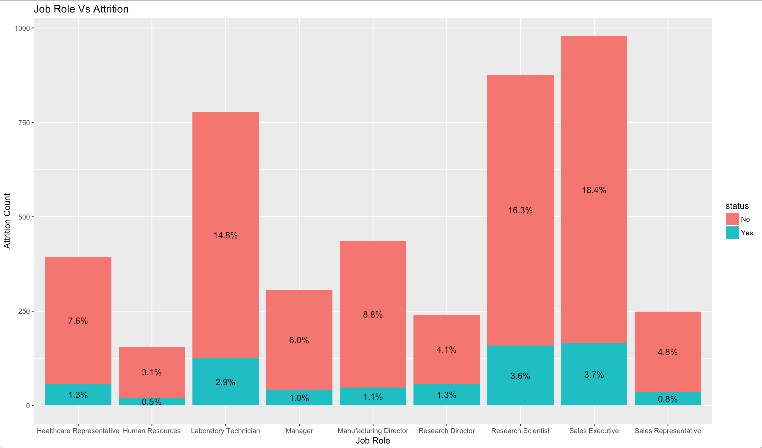
Bivariate Analysis – Job Role vs Attrition
Attrition is highest amongst
Sales Executives, Research
Scientists and Lab
Technicians

Slide 15
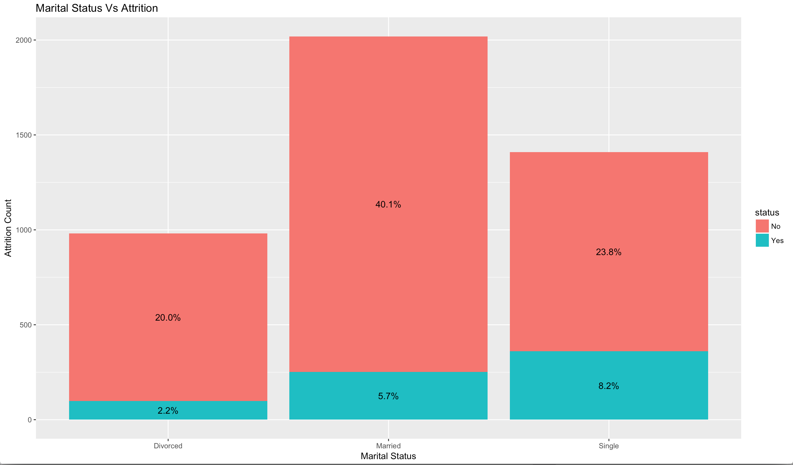
Bivariate Analysis – Marital Status vs Attrition
Attrition rate is highest 8.2% amongst Single and 5.7% amongst Married
Attrition rate is lowest 2.2% amongst divorcees

Slide 16
Final Logistic Regression Model
Age
NumCompaniesWorked
TotalWorkingYears
YearsSinceLastPromotion
YearsWithCurrManager
EnvironmentSatisfaction
JobSatisfaction
WorkLifeBalance
OverTime
BusinessTravelNon-Travel
BusinessTravelTravel_Frequently
MaritalStatusDivorced
MaritalStatusMarried
EducationFieldHuman Resources

Slide 17
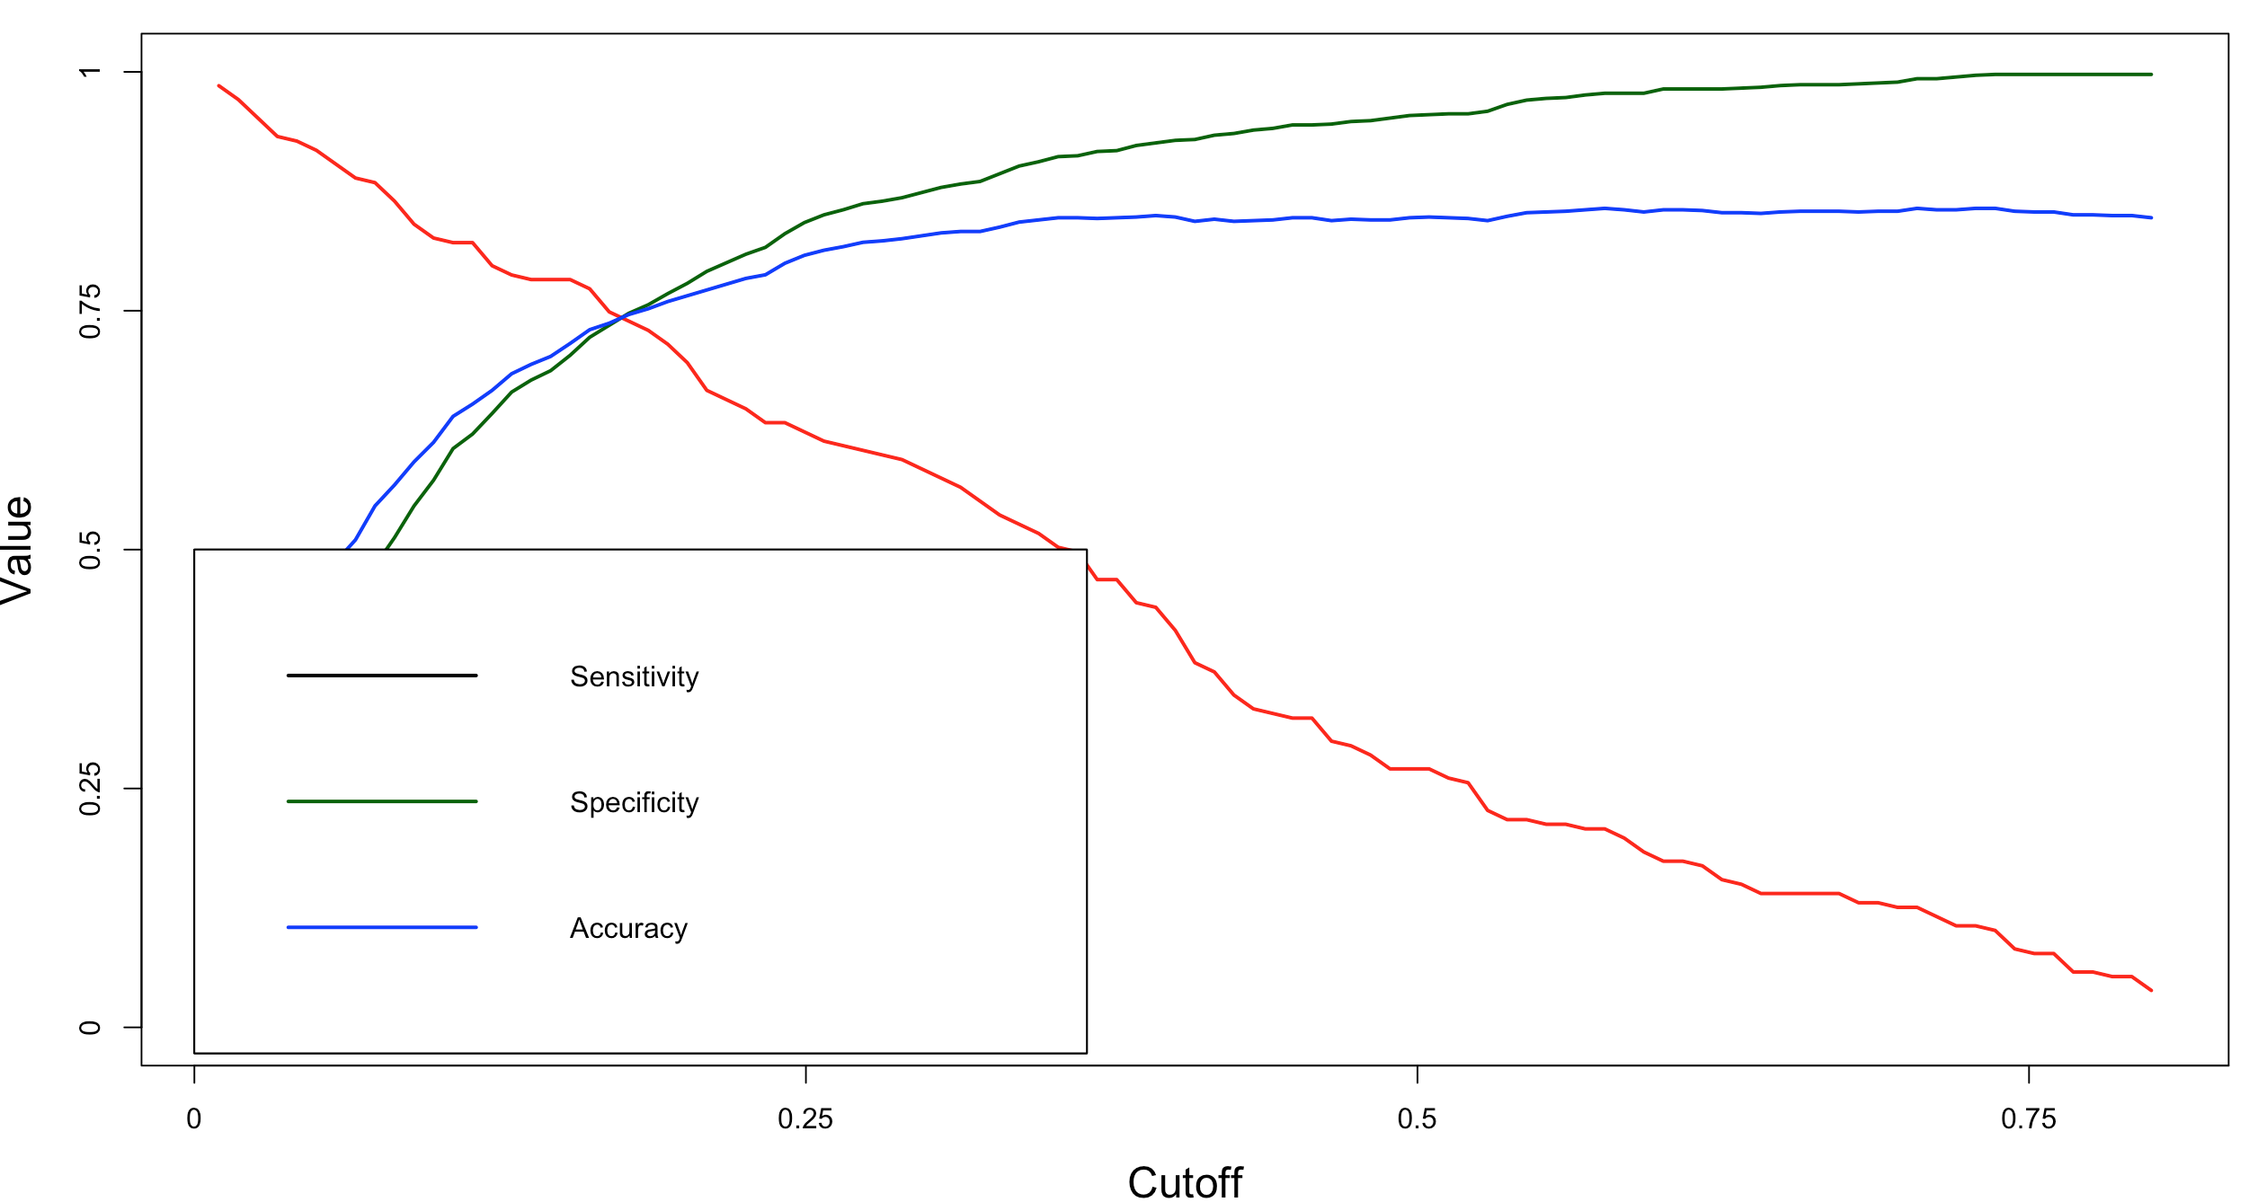
Model Evaluation
Confusion Matrix
Accuracy : 74.60%
Sensitivity : 73.91%
Specificity : 74.73%
Prediction | Actual |  | Total
 | No | Yes
No | 834 | 54 | 888
Yes | 282 | 153 | 435
Total | 1116 | 207 | 1323

Slide 18
Gain and Lift Charts

Slide 19
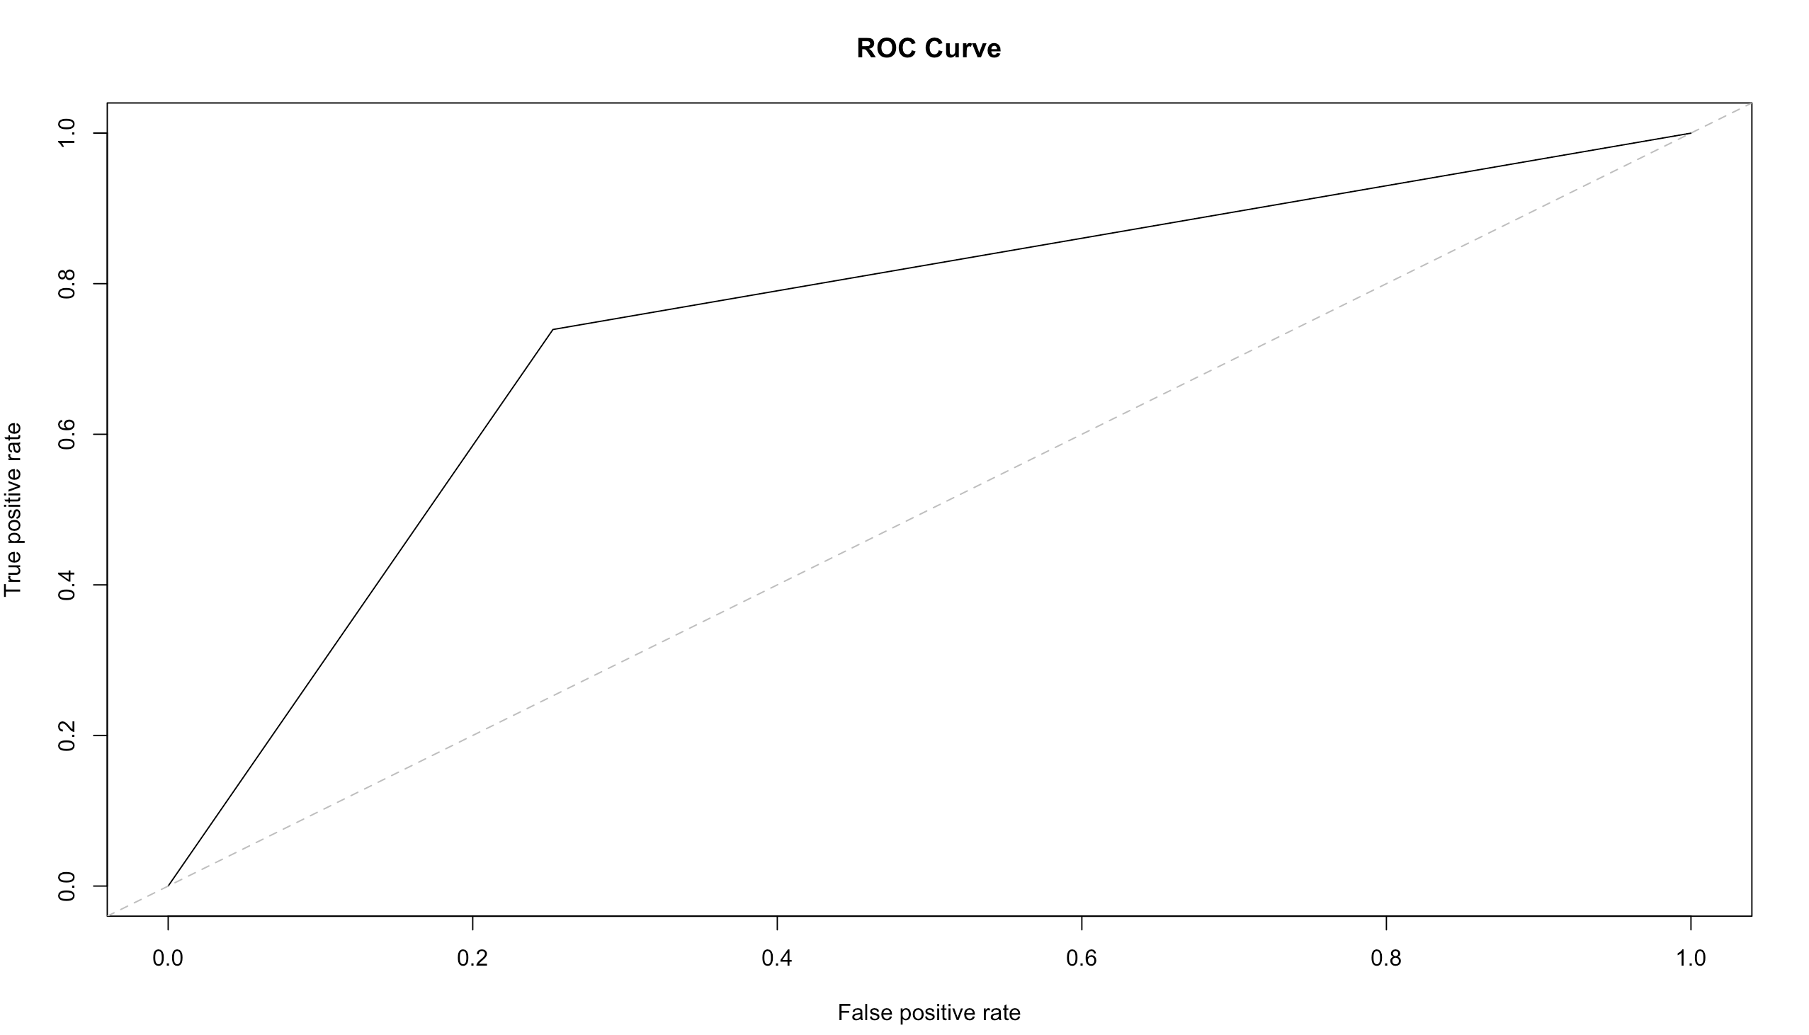
ROC Curve and KS Statistic
Area under the curve is 74.32%
and model predicts attrition
accurately 74% of the time
KS Statistic is 48.64 % > 40 %
and it shows the model is able
to discriminate the attrition and
non-attrition well

Slide 20
Relationship of Attributes to Attrition
 | Relationship with Attrition | Effect of variable on Attrition
Age | -0.37649 | As Age increases it decreases the probability of the employee leaving the company
NumCompaniesWorked | +0.44514 | Lower the number of companies the employee has worked for lesser the chance of leaving
TotalWorkingYears | -0.48535 | Lower the employee number of years in the company higher the chance of attrition
YearsSinceLastPromotion | +0.58642 | Greater the number of years since last promotion higher the chance of leaving
YearsWithCurrManager | -0.51565 | Lower the number of years with current manager increases the chance of attrition
EnvironmentSatisfaction | -0.43625 | Lower the environment satisfaction of employee greater the chance of leaving
JobSatisfaction | -0.39398 | Lower the job satisfaction level of employee greater the chance of leaving the company
WorkLifeBalance | -0.23933 | Lower the work life balance of employee higher the chance of attrition
OverTime | +1.68617 | Increase in overtime of the employee greatly increases the chance of employee leaving
BusinessTravelNon-Travel | -0.95339 | More time the employee remains without any business travel increases chance of leaving
BusinessTravelTravel_Frequently | +0.80657 | Too many frequent travels for the employee increases the chance of leaving the company
MaritalStatusDivorced | -1.25312 | Divorced employee has a lower chance of leaving the company
MaritalStatusMarried | -0.86023 | Married employee as opposed to single has a lower chance of leaving the company
EducationFieldHuman Resources | +1.67021 | Employee with education in HR have more tendency to leave the company

Slide 21
Recommendations
XYZ will be able to minimise attrition and significantly improve the employee working conditions by implementing the following recommendations:
Keep an eye on the employee overtime and balance workload in order to reduce stress of the employee
Ensure that an employee does travel in a calendar year but not too frequently as it disrupts work life balance
An employee remaining for a number of years without promotion must be carefully reviewed by the company
Focussed Interactions must be had with employees having lower satisfaction level and reasons understood
Employees with education in HR must be constantly motivated to perform
An employee would be more satisfied at work when remaining with one line manager for a longer duration

